Slide 1
Bike Sharing Demand Analysis Project
NextHikes IT Solutions

Slide 2
Bike Sharing Demand Analysis
Name: Yogesh Kumar
Date: 15-10-2025

Slide 3
Introduction
Overview of bike sharing systems
Importance of demand prediction for service optimization

Slide 4
Project Objective
Predict hourly/daily bike sharing demand
Improve availability and reduce wait times

Slide 5
Data Processing in Excel
Data cleaning and handling missing values
Normalization and feature engineering (e.g., creating time-based categories)

Slide 6
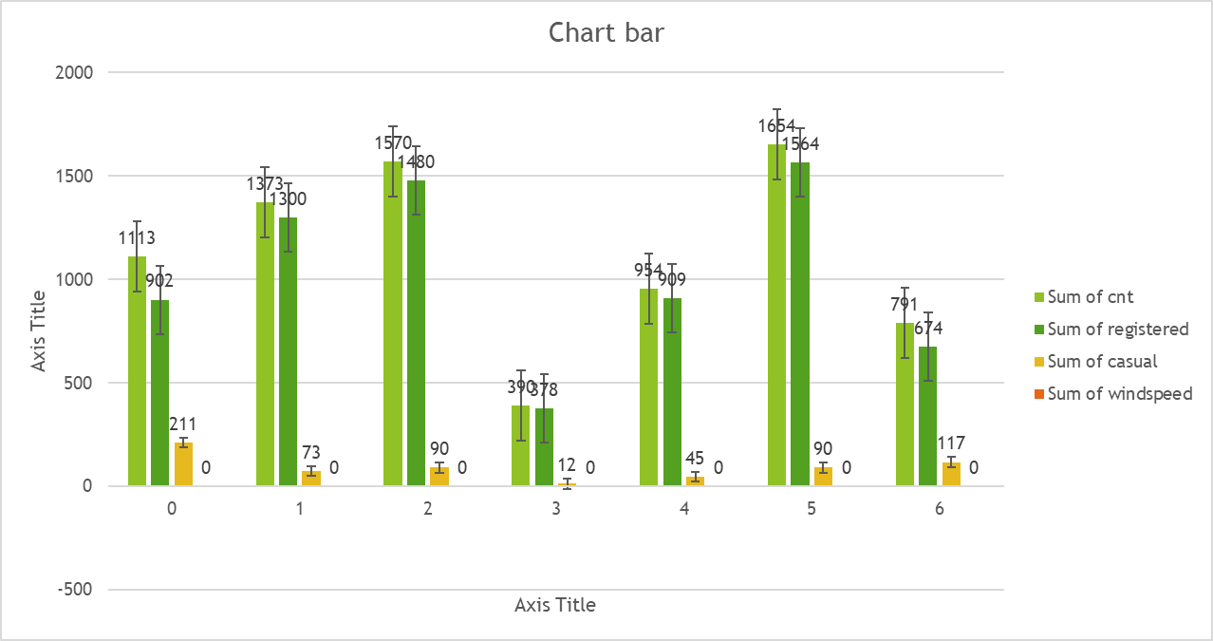
Exploratory Data Analysis

Slide 7
Insights from the Provided Chart
Weekday Analysis: The chart displays demand for each weekday, labeled from 0 to 6 (where typically 0 = Sunday, 6 = Saturday).
Count Comparison: For each weekday, there are bars representing the total number of rides ("Sum of cnt") and registered users ("Sum of registered").
Observations:The highest demand appears on weekdays 1 and 5 (typically Monday and Friday), both for total users and registered users.
There is a dip in demand on weekday 2 (Tuesday), and lower counts again on weekends (0 and 6).
Registered users make up the majority of users across all days, as casual users are not explicitly shown but are the difference between total and registered users.

Slide 8
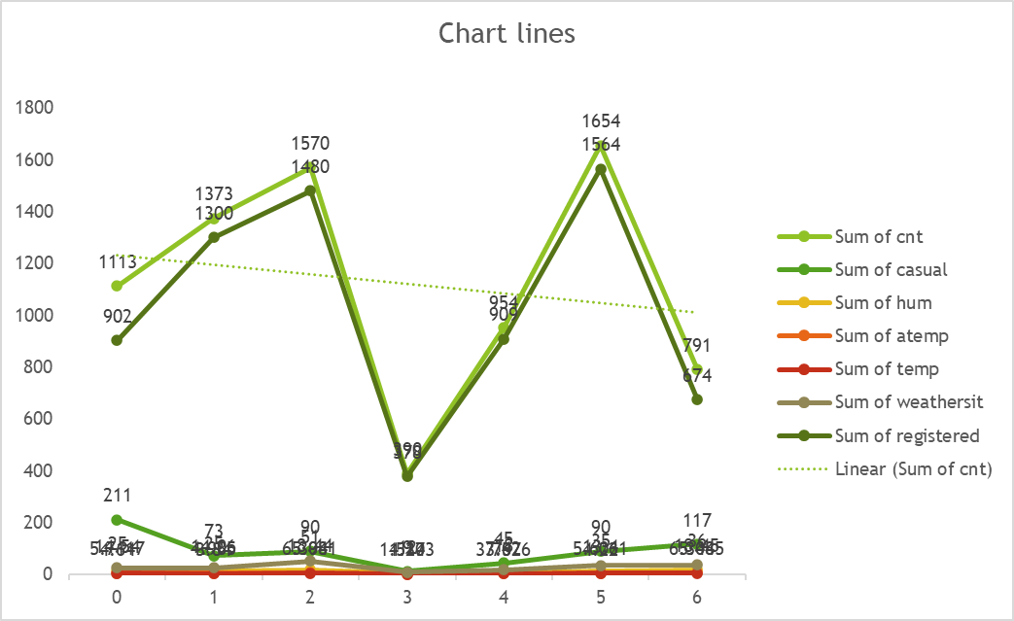
LINE CHART

Slide 9
LINE CHART INFORMATION
Total Demand by Weekday: The "Sum of cnt" (total ride count) shows clear peaks and valleys by weekday, with higher demand on days 1, 2, and especially 5 (likely Monday, Tuesday, and Friday). The demand dips mid-week (day 3).
Casual Users: The "Sum of casual" (orange line) remains significantly lower than the total count, indicating that registered users form the majority.
Other Variables: "Sum of hum" (humidity) and "Sum of atemp" (apparent temperature) are included as flat lines (very little variation), suggesting weather conditions do not fluctuate much across the weekdays in this filter selection or have a limited impact compared to user type.

Slide 10
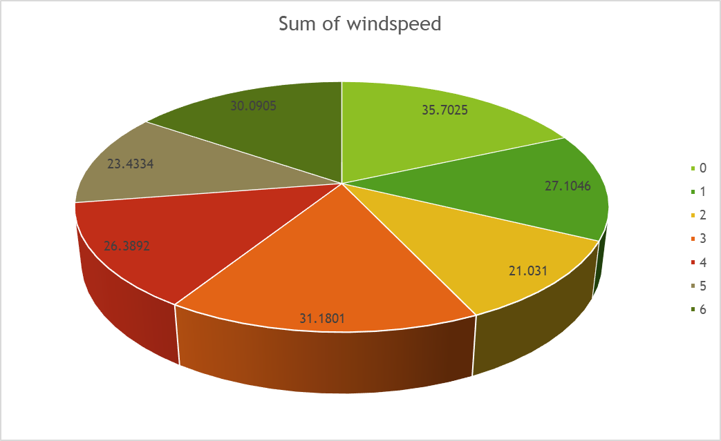
Insights from the Windspeed Pie Chart

Slide 11
Insights from the Windspeed Pie Chart Information
Variable Analyzed: The chart displays the total (sum) windspeed for each day of the week (coded as 0 to 6).
Distribution: Windspeed values for each weekday range from about 21 to 36, indicating some variability.
Highest and Lowest Windspeed:
  The highest mean summed windspeed is on day 1 (35.7025), which may correspond to Monday.
  The lowest is on day 5 (21.031), likely Friday or Saturday depending on weekday coding.
Other Notable Values: Days 0 and 4 also have relatively high windspeed, while days 2, 3, and 6 are moderate.

Slide 12
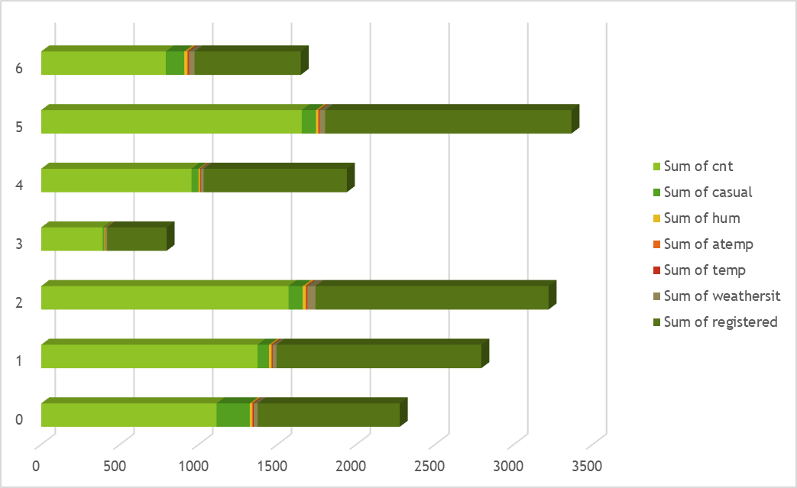
The Stacked Bar Chart

Slide 13
The Stacked Bar Chart
Variables Analyzed: The chart displays the "Sum of cnt" (total rides), "Sum of casual" (casual users), and "Sum of hum" (humidity) for each weekday (0 to 6).
Key Demand Patterns:
  The largest total demand (Sum of cnt, blue bars) is observed on weekdays 5 and 2, likely corresponding to Friday and Tuesday.
  Weekdays 3 and 4 exhibit the lowest total bike usage, indicating possible midweek lulls.
  Casual users (orange bars) form a small portion of total demand, showing that registered users dominate, especially on high-demand days.
Humidity: Humidity (grey bars) remains relatively consistent across different weekdays, implying it does not significantly vary or may have minor influence on bike demand patterns in this selection.
Comparative Trends:
  The spread of bike demand is not even throughout the week; certain weekdays consistently see more traffic, which can guide bike allocation and staffing.

